Slide 1
Classification Model
Classification: Basic Concepts
Rule-Based Classification
Decision Tree Induction
Bayes Classification Methods
kNN Classifier
Performance Evaluation
Ensemble Classification
Summary
1
Notes:
1

Slide 2
Model Evaluation and Selection
Evaluation metrics: How can we measure accuracy? Other metrics to consider?
Use validation test set of class-labeled tuples instead of training set when assessing performance of the classifiers
Methods for estimating a classifier’s performance:
Holdout method, random subsampling
Bootstrap
Cross-validation
2

Slide 3
Holdout Method
The holdout method is a data splitting technique that divides the original dataset into two subsets such as, training set and test set.
The training set is used to build and train the classifier, while the test set is used to evaluate how well the model can generalize to new data.
The test set is also called the holdout set, because it is held out from the model development process.
To apply the holdout method, you need to decide how to split the data into training and test sets.

Slide 4
Holdout Method
A common rule of thumb is to use two-thirds of the data for training and one-third for testing.
But this may vary depending on the size and characteristics of the data.
The model is trained on training data and evaluated on test data.
Here, we need to ensure that the two sets are representative of the original data, meaning that they have similar distributions and proportions of objects and classes.
This can be done by stratified sampling, which preserves the relative frequencies of different groups in the data.

Slide 5
Sampling
Sampling: obtaining a small sample s to represent the whole data set N
Stratified sampling: Approximate the percentage of each class in the overall database
Raw Data
Stratified Sample
5

Slide 6
Limitations
i) Fewer objects are available for training as some of the objects are withheld for testing. As a result, the trained model may not be as good as when all the labeled objects are used for training.
ii) The model may be highly dependent on the composition of the training and test sets.
- The smaller the training set size, the larger the variance of the model.
- On the other hand, if the training set is too large, then the estimated test accuracy is less reliable. With a very large training set, the model may become overly specialized in recognizing patterns in the training data, making it less generalizable to unseen test data (Overfitting to Training Data).

Slide 7
Advantages
It is simple and easy to implement, requiring only one split of the data.
It is efficient and fast, as it only requires one run of the model on the test set.

Slide 8
Disadvantages
The holdout method also has some disadvantages that limit its reliability and usefulness.
It is sensitive to the choice of the split, as different splits may result in different model performance and accuracy.
It is wasteful and potentially biased, as it does not use all the available data for training or testing.
It is unstable and variable, as it may not reflect the true performance of the model over multiple runs.

Slide 9

Random subsampling
The holdout method can be repeated several times to improve the estimation of the classifier’s performance. This approach is known as random subsampling.
Let Acc_{i} be the model accuracy during the i-th iteration. The overall accuracy is given by
Random sampling still encounters some of the problems associated with the holdout method because it does not utilize as much data as possible for training.
It also has no control over the number of times each record is used for testing and training. Consequently, some objects might be used for training more often than others.

Slide 10
Bootstrap
The methods presented so far assume that the training records are sampled without replacement. As a result, there are no duplicate records in the training and test sets.
Bootstrap is a technique that resamples the data with replacement.
This means that some data points may be included in the resampled dataset multiple times, while others may not be included at all.
The model is then trained on the resampled dataset and evaluated on the test dataset (not in the bootstrap sample).
This process is repeated multiple times, and the results are averaged to get an estimate of the model's performance.

Slide 11
Bootstrap
Bootstrap
Works well with small data sets
Samples the given training tuples uniformly with replacement
i.e., each time a tuple is selected, it is equally likely to be selected again and re-added to the training set
There are several bootstrap methods, and a common one is 0.632 boostrap
0.632 boostrap:
Let D is a data set with size |D|=N. Let dataset D₁ is the bootstrap sample set with same size, N. Here, random sampling with replacement is used to make D₁ from D. So some samples may appear many times and some may not appear in D₁.
The bootstrap samples (i,.e., D₁) is used as training set and the samples of D not included in D₁ is the test set, say T₁.
11

Slide 12



Bootstrap
On average, a bootstrap sample set, (i.e. D₁), contains approximately 63% samples of the original dataset because, each sample of D has a probability of being selected in D₁. How?
- Probability that a sample is selected in D₁ = .
- Therefore, probability that the sample is not selected in
D₁ =
- Since, we are using sampling with replacement, so for second time sample selection in D₁, probability that the sample is not selected in D₁ is also =
- Since, the size of D₁ is also = N, so the probability that a sample of D is not selected =

Slide 13


Bootstrap
Therefore, the probability of each sample of D is selected in D₁ =
If N is sufficiently large, this probability converges to
The samples of D, which are not in D₁ is the test set, T₁.
Repeat the sampling procedure k times, we get the models, M₁, M₂, …, M_{k}, where, the training and test set for M_{i} are D_{i} and T_{i} respectively.
Therefore, the overall accuracy of the model:
Accuracy_{test}​ = average accuracy on test sets
Accuracy_{train}​ = average accuracy on the training sets.

Slide 14
Bootstrap
In holdout method, the test data is never seen by the model during training, its accuracy gives an unbiased estimate of generalization performance. That is why, only test accuracy is considered.
In the holdout method, each data point is used only once (either for training or testing).
In bootstrap, the same data points are reused in different bootstrap samples, so same samples are reused in different test set which can lead to bias in test accuracy.
To correct for this bias, bootstrap uses the 0.632 rule, incorporating training accuracy to balance the estimate.

Slide 15
Why used both Training or Test Accuracy?
The 0.632 accuracy equation is used because it balances the bias from training accuracy and the variance from test accuracy, providing a more reliable estimate of a classifier’s performance.
Training accuracy (Accuracy_{train}​) is overoptimistic because the classifier is tested on the same data it was trained on.
Test accuracy (Accuracy_{test}​) from test samples is more realistic but is based on a subset (36.8%) of the data, which introduces higher variance.
Thus, relying on either alone is not ideal.

Slide 16
Why the 0.632 Weight?
Since not all data points are used for testing, relying only on test accuracy would result in high variance due to limited test data.
The training accuracy is considered to compensate for the bias in the test accuracy.
To balance the contributions of both training and test accuracy, the equation gives:
63.2% weight to the test accuracy (since it better estimates generalization performance).
36.8% weight to training accuracy (to compensate for the reduced training set size in each bootstrap iteration).

Slide 17
Bootstrap
1. Advantages
Reduces the overfitting bias of training accuracy.
Provides a better accuracy estimate compared to simple holdout validation.
More stable than k-fold cross-validation for small datasets.
2. Limitations
May still have some bias, especially if the classifier overfits to the training data.
Computationally expensive for large datasets, as multiple bootstrap samples are required.

Slide 18
Cross-validation
K-fold Cross-validation (k-fold, where k = 10 is most popular)
Randomly partition the data into k mutually exclusive subsets, each approximately equal size
At i-th iteration, use D_{i} as test set and others as training set
Leave-one-out: k folds where k = # of tuples, for small sized data
Cross validation with k = 3
Training
Training
Testing
Training
Testing
Training
Testing
Training
Training

Slide 19
Cross-validation
Stratified cross-validation: folds are stratified so that class distribution in each fold is approximately the same as that in the initial data
Stratified sample
original data

Slide 20
Classifier Evaluation Metrics: Confusion Matrix
A confusion matrix, as the name suggests, is a matrix of numbers that tell us where a model gets confused.
It is a class-wise distribution of the predictive performance of a classification model, i.e., the confusion matrix is an organized way of mapping the predictions to the original classes to which the data belong.
A binary class dataset is one that consists of just two distinct categories of data. These two categories can be named the “positive” and “negative” for the sake of simplicity.

Slide 21
Confusion Matrix for Binary Classifier
The basic classifier evaluation metrics are: Accuracy, Precision, Recall, and F-Measure
These metrics are defined by the following terms:
True Positive (TP): Positive class correctly classified as positive
False positive (FP): Negative class incorrectly classified as positive
True Negative (TN): Negative class correctly classified as negative
False Negative (FN): Positive class incorrectly classified as negative
Usually, the larger class is the negative class

Slide 22
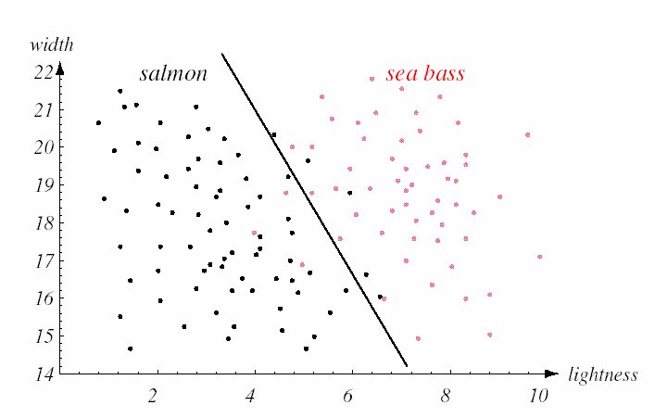
Classifier Evaluation Metrics: Confusion Matrix
Classification
False Positive
Attribute 4
Negative
POSITIVE
False Negative
Attribute 2

Slide 23
Classifier Evaluation Metrics: Confusion Matrix
Classifier Accuracy, or recognition rate: percentage of test set tuples that are correctly classified.
Accuracy (A) = (TP+TN) / (TP+ TN + FP + FN)
Error Rate (E) = 1 – Accuracy = (FP+FN) / (TP+ TN + FP + FN)

Slide 24
Classifier Evaluation Metrics: Confusion Matrix
In many cases, accuracy may be very high but the model is not useful, in case of class imbalanced data set.
Let in disease data set, positive samples are very few compare to negative samples.
If the model predict most of the negative samples correctly but predict correctly very few of the positive samples, then though the accuracy is very high still the model is not useful.
In this situation, we use other performance metrics, such as precision, recall, etc.

Slide 25
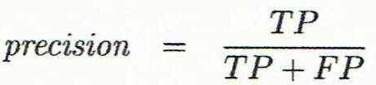
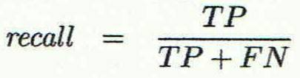
Classifier Evaluation Metrics: Confusion Matrix
Precision: exactness – what % of tuples that the classifier labeled as positive are actually positive?
Recall: completeness – what % of positive tuples did the classifier label as positive?
Perfect score of Precision and Recall is 1.0
There is an inverse relationship between precision & recall

Slide 26
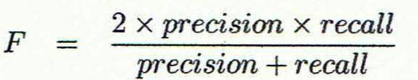
Classifier Evaluation Metrics: Confusion Matrix
F-Measure (F₁ or F-score): harmonic mean of precision and recall.

Slide 27

Classifier Evaluation Metrics: Confusion Matrix
F_{ß}: weighted measure of precision and recall. It assigns ß times as much weight to recall as to precision
It means that recall is considered ß times more important than precision
If ß > 1, recall is more
important than precision.
If ß < 1, precision is more
important than recall.
If ß = 1, it becomes the standard F1-score, where precision and recall are equally weighted

Slide 28


Classifier Evaluation Metrics: Sensitivity and Specificity
Sensitivity: True Positive recognition rate = = Recall
Specificity: True Negative recognition rate =
Actual Class \ Predicted class | cancer = yes | cancer = no | Total | Recognition(%)
cancer = yes | 90 | 210 | 300 | Sensitivity = 30.00
cancer = no | 140 | 9560 | 9700 | Specificity = 98.56
Total | 230 | 9770 | 10000 | Accuracy=96.40
Precision=90/230 = 39.13, Recall=90/300=30.00, F-Score=33.96
28

Slide 29
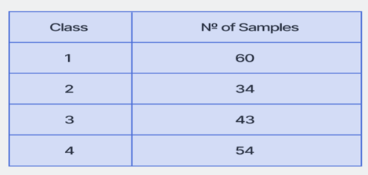
Confusion Matrix for Multiple Classes
The concept of the multi-class confusion matrix is similar to the binary-class matrix. Let, the columns represent the actual class, and the rows represent the predicted class distribution by the classifier.
Let us elaborate on the features of the multi-class confusion matrix with an example.
Suppose we have the test set (consisting of 191 total samples) of a dataset with the following distribution:
29

Slide 30
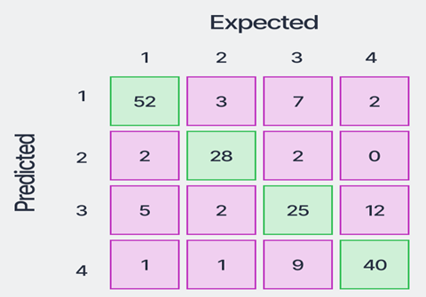
Confusion Matrix for Multiple Classes
The confusion matrix obtained by training a classifier and evaluating the trained model on this test set is shown below.
Let that matrix be called “M,” and each element in the matrix be denoted by M_{ij} , where “i” is the row number (predicted class), and “j” is the column number (Actual or expected class), e.g., M₁₁=52, M₄₂=1.

Slide 31
Confusion Matrix for Multiple Classes
This confusion matrix gives a lot of information about the model’s performance.
As usual, the diagonal elements are the correctly predicted samples. A total of 145 samples were correctly predicted out of the total 191 samples. Thus, the overall accuracy is 75.92%.
M₂₄=0 implies that the model does not confuse samples originally belonging to class-4 with class-2, i.e., the classification boundary between classes 2 and 4 was learned well by the classifier.

Slide 32
Confusion Matrix for Multiple Classes
To improve the model’s performance, one should focus on the predictive results in class-3.
A total of 18 samples (adding the numbers in the red boxes of column 3) were misclassified by the classifier, which is the highest misclassification rate among all the classes.
Accuracy in prediction for
class-3 is, thus,
25/(25+18)=58.14% only.

Slide 33
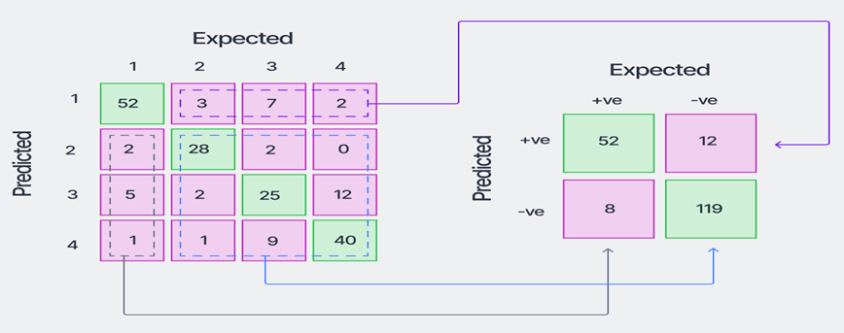
Confusion Matrix for Multiple Classes
The confusion matrix can be converted into a one-vs-all type matrix (binary-class confusion matrix) for calculating class-wise metrics like accuracy, precision, recall, etc.
Converting the matrix to a one-vs-all matrix for class-1 of the data looks like as shown below.

Slide 34
Confusion Matrix for Multiple Classes
Here, the positive class refers to class-1, and the negative class refers to “NOT class-1”. Now, the formulae for the binary-class confusion matrices can be used for calculating the class-wise metrics.

Slide 35
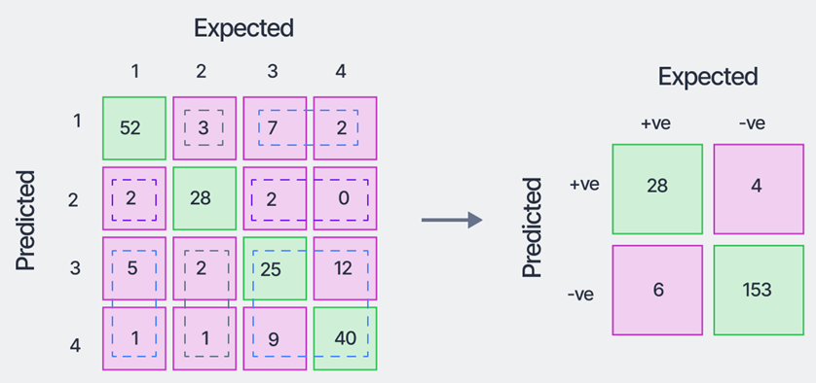
Confusion Matrix for Multiple Classes
Similarly, for class-2, the converted one-vs-all confusion matrix will look like the following:

Slide 36
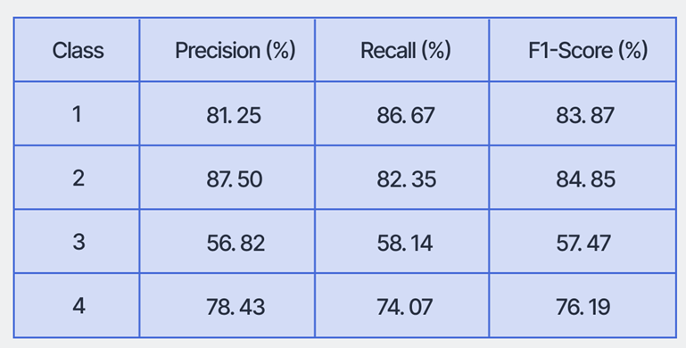
Confusion Matrix for Multiple Classes
Using this concept, we can calculate the class-wise accuracy, precision, recall, and f1-scores and tabulate the results:

Slide 37
Confusion Matrix for Multiple Classes
In addition to these, two more global metrics can be calculated for evaluating the model’s performance over the entire dataset.
These metrics are variations of the F1-Score we calculated earlier.
These are:
i) Micro-averaged F1-score, and
ii) Macro-averaged F1-Score

Slide 38
Micro-averaged F1-score
The micro-averaged F1-score is a global metric that is calculated by considering the
i) Net TP, i.e., the sum of the class-wise TP (from the respective one-vs-all matrices),
ii) Net FP, and
iii) Net FN
These are obtained as follows:
Net TP = 52+28+25+40 = 145 Net FP = (3+7+2)+(2+2+0)+(5+2+12)+(1+1+9) = 46 Net FN = (2+5+1)+(3+2+1)+(7+2+9)+(2+0+12) = 46
Note that, the net FP and net FN have the same value.

Slide 39
Micro-averaged F1-score
Thus, the micro precision and micro recall can be calculated as:
i) Micro Precision = Net TP/(Net TP+Net FP) = 145/(145+46) = 75.92% ii) Micro Recall = Net TP/(Net TP+Net FN) = 75.92%
So, Micro F1-score = Harmonic Mean of Micro Precision and Micro Recall = 75.92%.
Here, Micro Precision = Micro Recall = Micro F1-Score = Accuracy = 75.92%

Slide 40
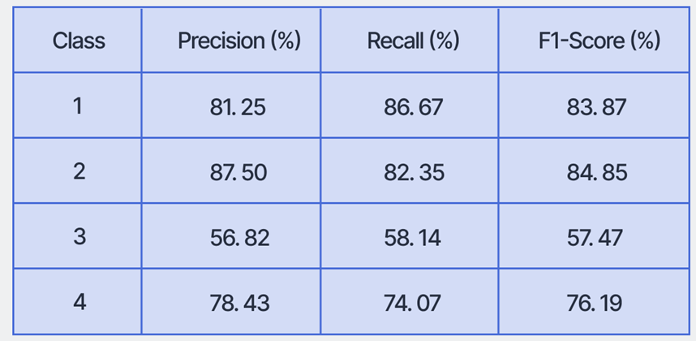
Macro unweighted average score
Macro averaged F1-Score: The macro-average scores are calculated for each class individually, and then the unweighted mean of the measures is calculated to calculate the net global score.
For the example we have been using, the scores are obtained as the following:
The unweighted
means of the measures
are:
Macro Precision = 76.00% Macro Recall = 75.31% Macro F1-Score = 75.60%

Slide 41
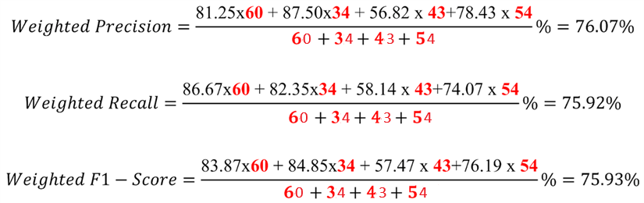
Macro weighted average score
Weighted F1-Score
The weighted-average scores take a sample-weighted mean of the class-wise scores obtained. So, the weighted scores obtained are:
The macro weighted-average scores take a sample-weighted mean of the class-wise scores obtained.
So, the macro weighted scores obtained are:

Slide 42

Receiver Operating Characteristics (ROC) curve
A Receiver Operating Characteristics (ROC) curve is a plot for displaying the tradeoff between “true positive rate” and “false positive rate” of a classifier at different threshold settings.
ROC curves are usually defined for a binary classification model, although that can be extended to a multi-class setting.
The definition of the true positive rate (TPR) coincides exactly with the sensitivity (or recall).
TPR is defined as the number of samples belonging to the positive class of a dataset, being classified correctly by the predictive model.
So the formula for computing the TPR is,

Slide 43
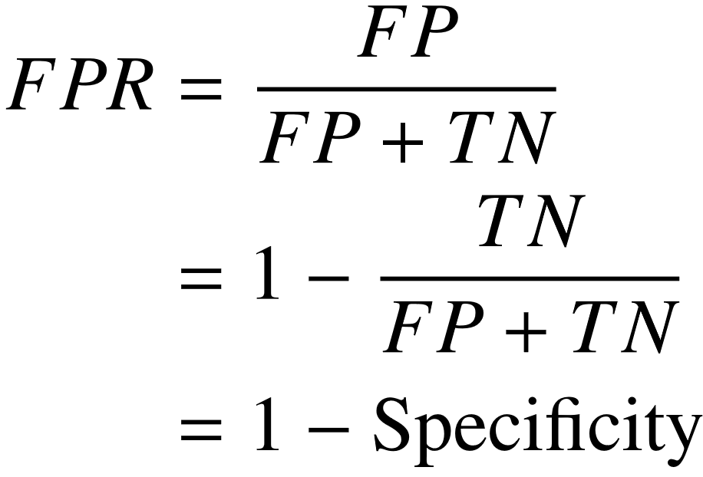
Receiver Operating Characteristics (ROC) curve
The false positive rate (FP) is defined as the number of negative class samples predicted wrongly to be in the positive class (i.e., the False Positives), out of all the samples in the dataset that actually belong to the negative class.
Mathematically it is represented as the following:
Note that, the FPR is the additive inverse of Specificity . So both the TPR and FPR can be computed easily from our existing computations from the Confusion Matrix.

Slide 44
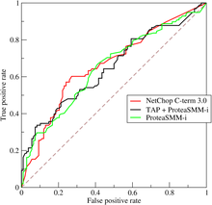
ROC curve
In a ROC curve, TPR is plotted along the y-axis and the FPR is plotted along the x-axis.
Each point along the curve corresponds to one of the models induced by the classifier.
Figure shows the ROC curves
for three different classifiers.

Slide 45
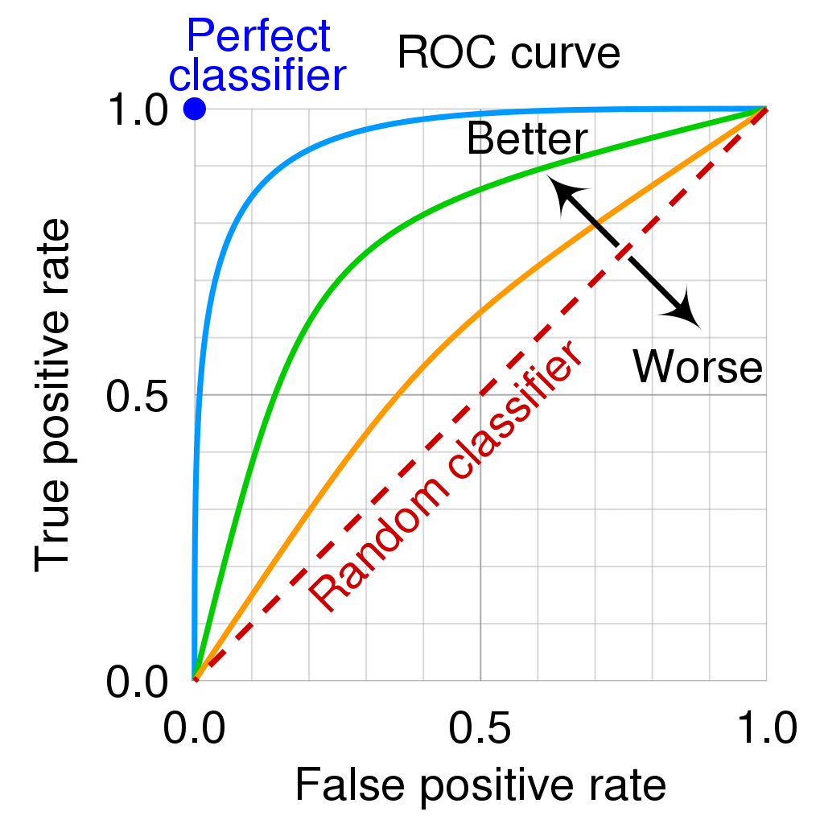
ROC Curve
There are several critical
points along an ROC curve
that have well-known
interpretations:
i) (TPR=0, FPR=0): Model predicts every instance to be a negative class.
ii) (TPR=1, FPR=1): Model predicts every instance to be a positive class.
iii) (TPR=1, FPR=0): The ideal model.

Slide 46
ROC Curve
A good classifier should be located
as close as possible to the upper left
corner of the diagram.
A model that makes random
predictions is called a Random
classifier or “No Skill” classifier.
This model should reside along the main diagonal, connecting the points (TPR=0, FPR=0) and (TPR=1, FPR=1).
In Random classifier, for a class-balanced dataset, the class-wise probabilities will be 50%. It acts as a reference line for the plot of the precision-recall curve.

Slide 47
ROC Curve
A perfect learner is one
which classifies every
sample correctly, and it
also acts as a reference line for the ROC plot.
A real-life classifier will have a plot somewhere in between these two reference lines.
The more a ROC of a learner is shifted towards the (TPR=0, FPR=1) point (i.e., towards the perfect learner curve), the better is its predictive performance across all thresholds.

Slide 48
ROC Curve
Another important metric that measures the overall performance of a classifier is the “Area Under ROC” or AUROC (or just AUC) value.
As the name suggests, it is simply the area measured under the ROC curve.
A higher value of AUC represents a better classifier. The AUC of the practical learner above is 90% which is a good score.
The AUC of the random classifier = 0.5 and that of perfect learner = 1.

Slide 49
Receiver Operating Characteristics (ROC) curve
We have mentioned earlier that an ROC curve is a plot for displaying the tradeoff between “true positive rate” and “false positive rate” of a classifier at different threshold settings.
Now, what do we mean by “thresholds” in the context of ROC curves?
- Different thresholds represent the different possible classification boundaries of a model. Let us understand this with an example.
Suppose we have a binary class dataset with 4 positive class samples and 6 negative class samples.

Slide 50
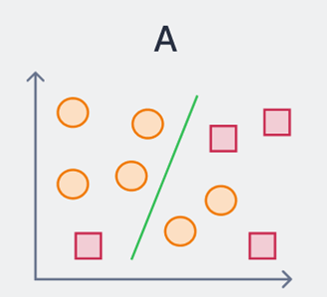
ROC Curve
Let the model decision boundary is as shown by the green line in case (A) below.
Let, the RIGHT side of the decision boundary depicts the positive class, and the LEFT side depicts the negative class.
Now, this decision boundary threshold can be changed to arrive at case (B), where the precision is 100% (but recall is 50%), or to case (C) where the recall is 100% (but precision is 50%).

Slide 51
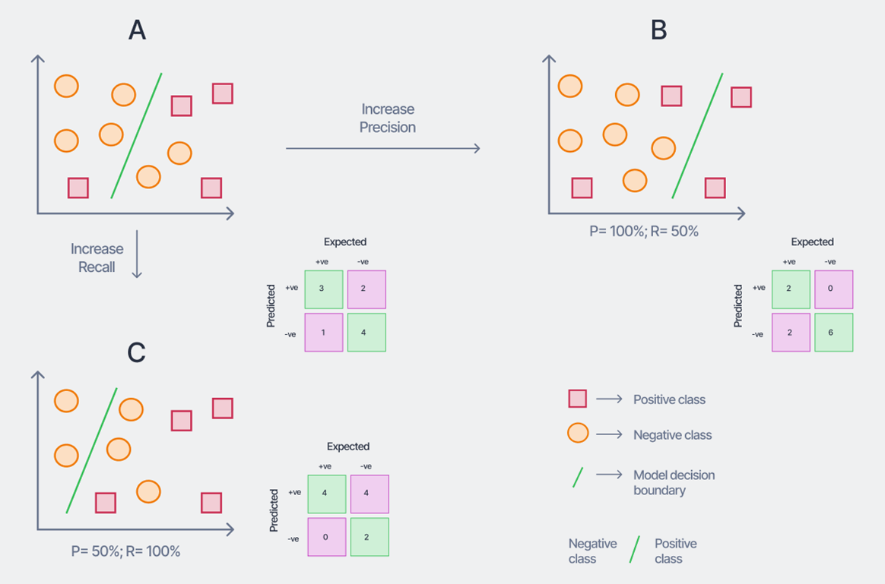
ROC Curve
Now, this decision boundary threshold can be changed to arrive at case (B), where the precision is 100% (but recall is 50%), or to case (C) where the recall is 100% (but precision is 50%). The corresponding confusion matrices are shown.

Slide 52
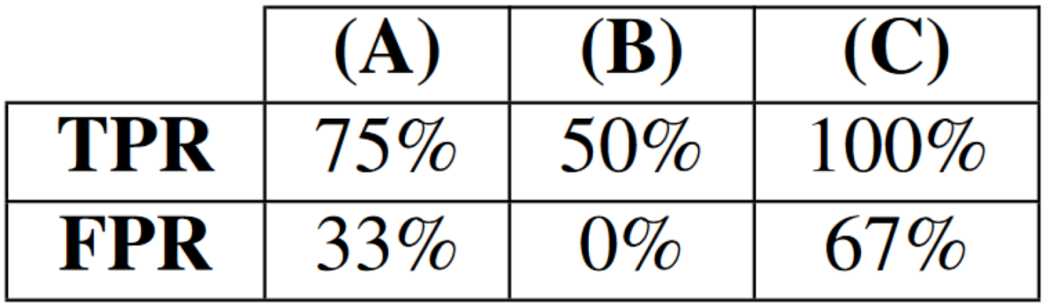
ROC Curve
The TPR and FPR values for these three scenarios with the different thresholds are thus as shown below.
To know in details about how to generate ROC curve, go through the book,
“Introduction to Data Mining” by TAN, STEINBACH, AND VIPIN KUMAR

Slide 53
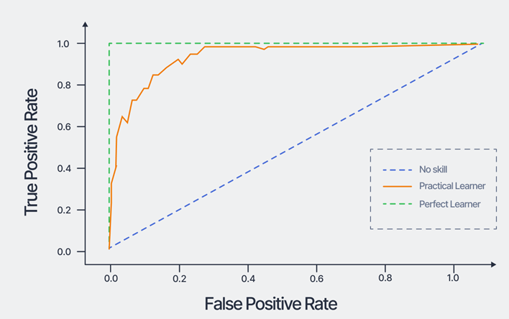
ROC Curve
Using these values, the ROC curve can be plotted. An example of a ROC curve for a binary classification problem (with randomly generated samples) is shown below.

Slide 54
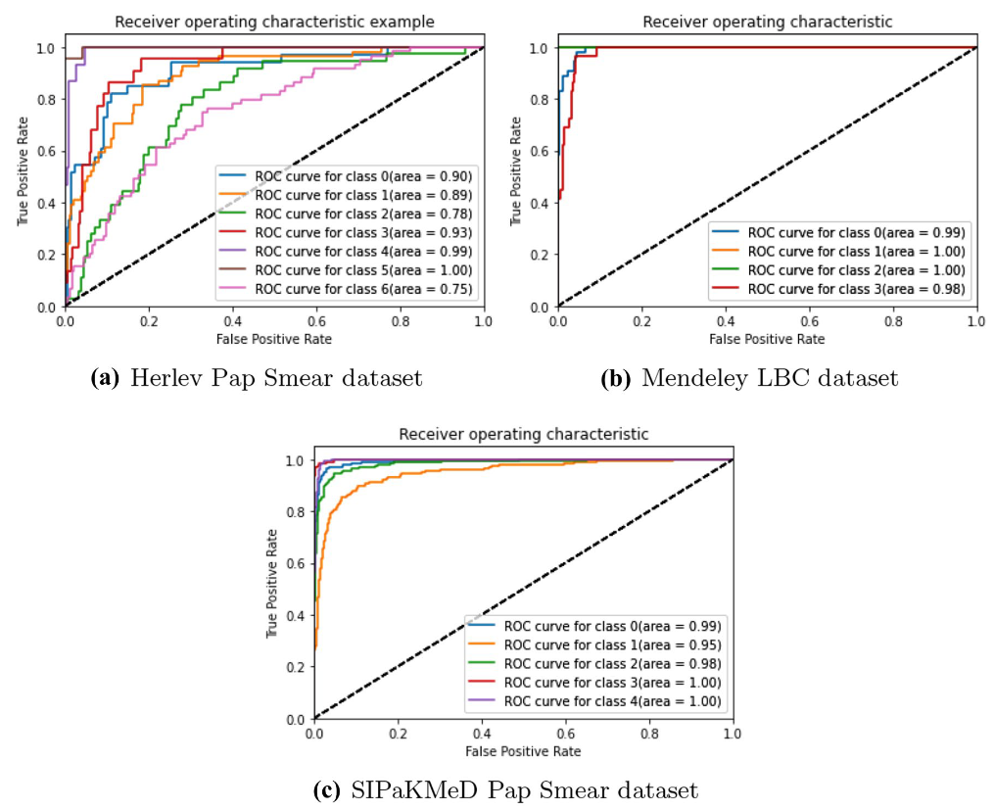
ROC Curve
For multi-class datasets, the ROC curves are plotted by dissolving the confusion matrix into one-vs-all matrices.

Slide 55


